Slide 1
Building A Scalable And Adaptive Architecture (1)

Slide 2
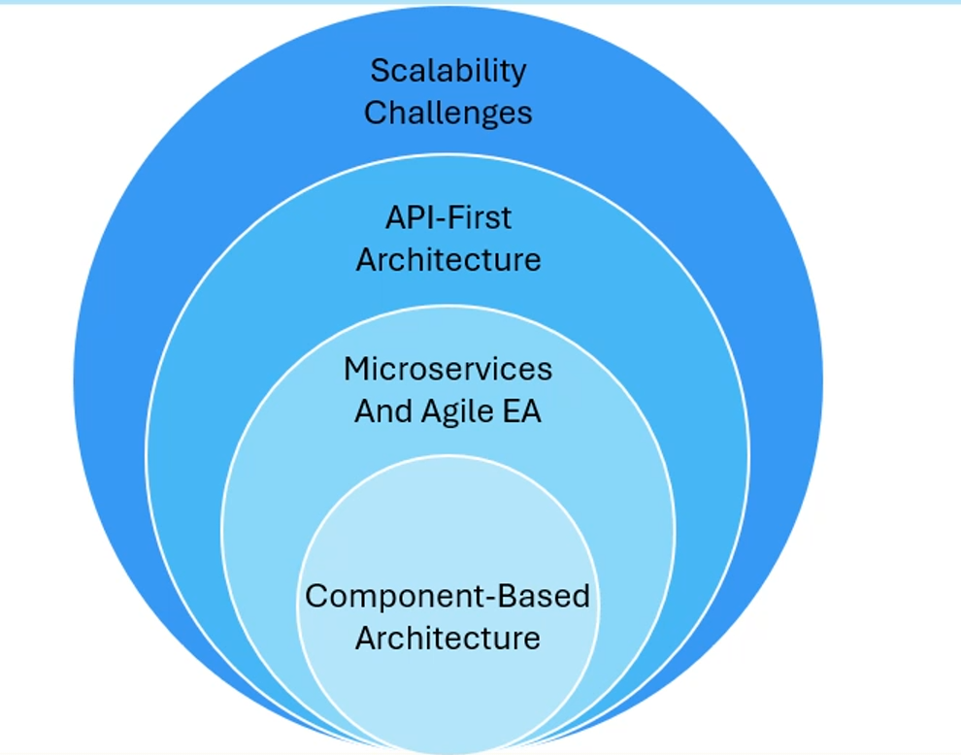
Building A Scalable And Adaptive Architecture

Slide 3
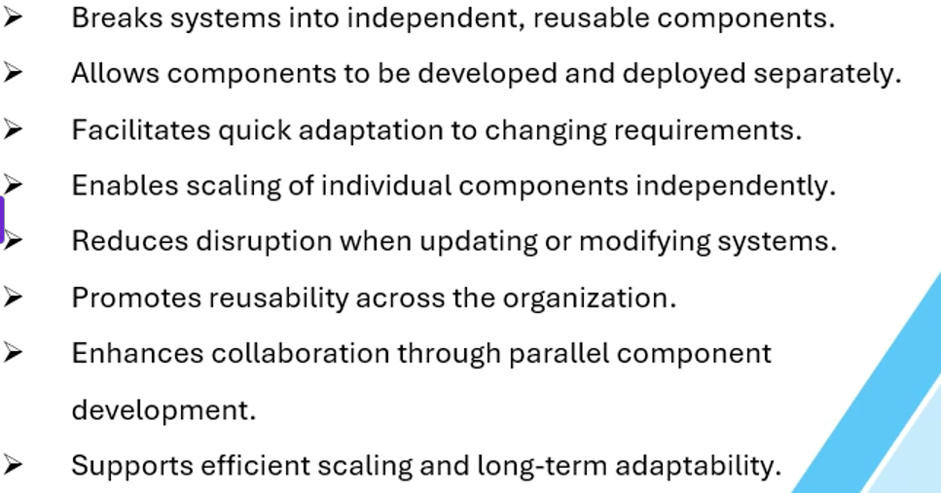
Component-Based Architecture

Slide 4
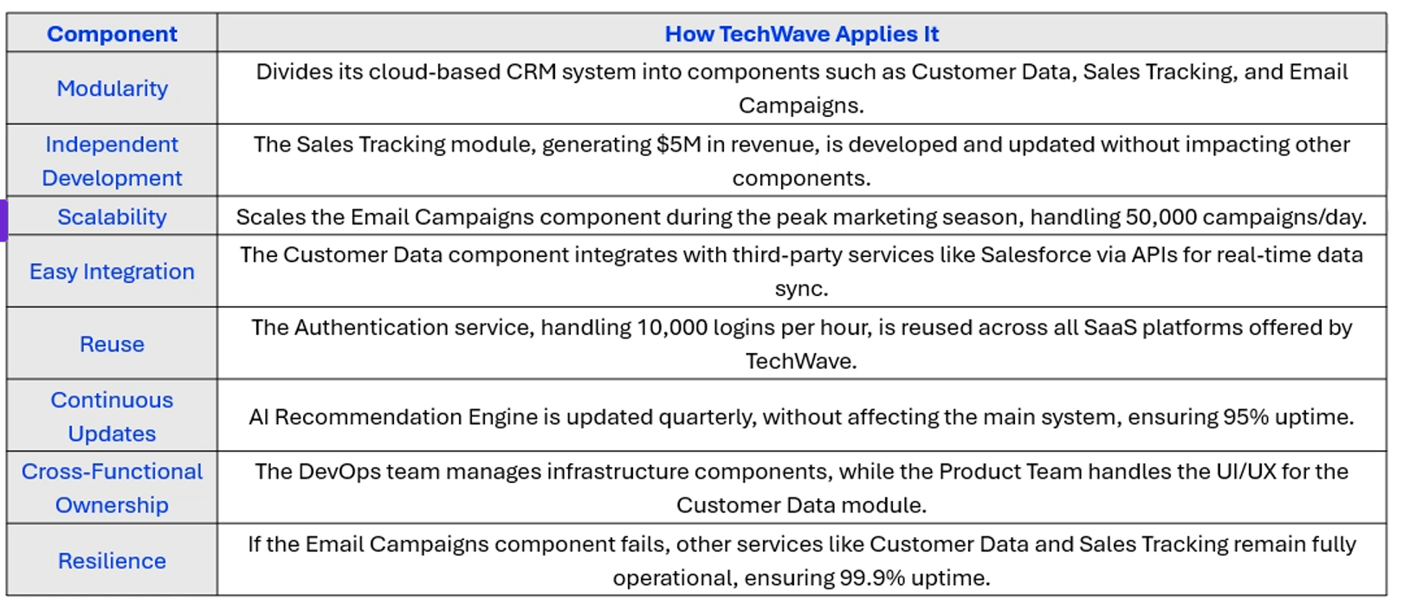
Component – Based Architecture At TechWave

